Slide 1
Driver Hiring Management System Developed in PHP & MySQL

Slide 2
Abstract
“Driver Hiring Management System” is web based application proposed here will help you find the best drivers for your ride.
Now days driver booking is getting very popular and Most of the people want an ease of travelling using drivers. Instead of asking for auto rickshaw and taxis. Since there are lots of applications available for driver booking.

Slide 3
Introduction
“Driver Hiring Management System” is a web-based technology that will manage the records of the driver and users. It’s an easy for Admin to retrieve the data of driver and users. Driver Hiring Management System is an automatic system which delivers data processing in very high speed in systematic manner. This application provides convenient and best service to customer (who wants to hire driver) and driver (which want to register) who easily register himself/herself.
In “Driver Hiring Management System” we use PHP and MySQL Database. This project has three modules i.e.
Admin
Driver
User

Slide 4
Admin Modules
Secure Admin Login
1. Dashboard: In this section, admin can briefly view the total number of registered users, total registered driver, total booking, pending booking, approved booking and total cancelled booking.
2. User Detail: In this section, admin views the user details and their booking details.
3. Driver Detail: In this section, admin views the driver details and their booking details.
4. Reports: In this section admin can view the booking details.
Admin can also update his profile, change the password and recover the password.

Slide 5
Driver Module
Dashboard: In this section, driver can briefly view the total booking, pending booking, approved booking and total cancelled booking.
Booking History: In this section, driver can view and approved and cancelled the booking.
Reports: In this section, driver can view the booking details.
Driver can also update his profile, change the password and recover the password.

Slide 6
User Module
1. Home: In this section, user can view the welcome page of the web application and after registering they can hire the driver.
2. My Profile: In this section, user can update his/her profile.
3. Change Password: In this section, user changes the account password.
4. Book History: In this section, user can view history of driver booking.

Slide 7
Purpose
In last few years technology has been very much ahead in all fields. It plays vital role in human commerce. For human commerce there are many application and websites are available on internet which has made life easy. Likewise, this application provides a driver on demand to customer wherever he/she needs. Another purpose for developing this application is to generate the report automatically. This software design specification is made with the purpose of outlining the software architecture and design of the “Driver Hiring Management System” in detail.
Scope:
In this system, the User is able to hire a driver by entering the details such as place, dates, days, vehicle type, etc. The system will list down the drivers. The Driver can cancel the ride if he is not available and there is admin which view the activity of driver and users.

Slide 8
Requirement Specification
Hardware Configuration:
Client Side
Server Side
RAM | 512 MB
Hard Disk | 10GB
Processor | 1.0 GHz
RAM | 1 GB
Hard Disk | 20GB
Processor | 2.0GHz

Slide 9
Continue.....
Software Requirement:
Client Side
Server Side
Web Browser | Google Chrome or any compatible browser
Operating System | Windows or any equivalent OS
Web Server | APACHE
Server side Language | PHP5.6 or above version
Database Server | MySQL
Web Browser | Google Chrome or any compatible browser
Operating System | Windows or any equivalent OS

Slide 10
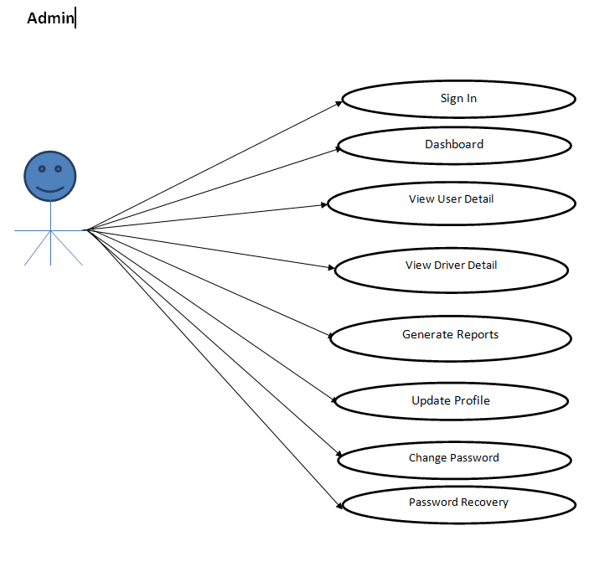
Use Case Diagram
Notes:
USECASE DIAGRAM: A Use case is a description of set of sequence of actions. Graphically it is rendered as an ellipse with solid line including only its name. Use case diagram is a behavioral diagram that shows a set of use cases and actors and their relationship. It is an association between the use cases and actors. An actor represents a real-world object. Primary Actor – Sender, Secondary Actor Receiver.

Slide 11
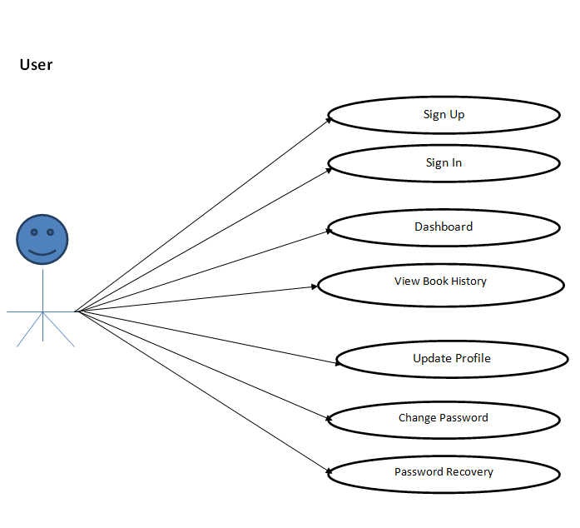
Continue.......

Slide 12
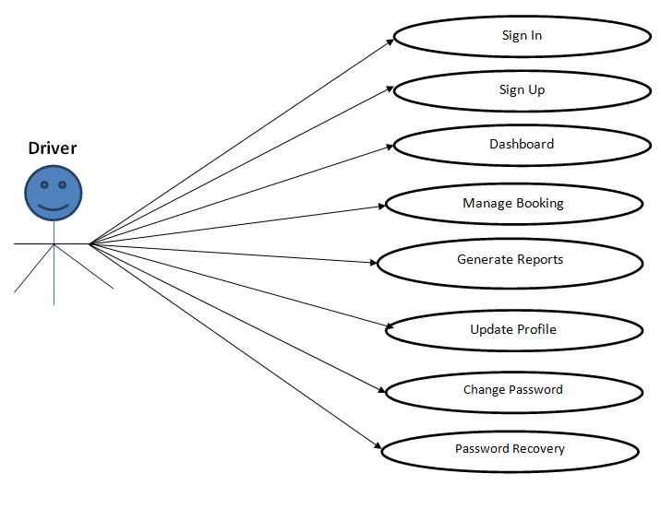
Continue.......

Slide 13
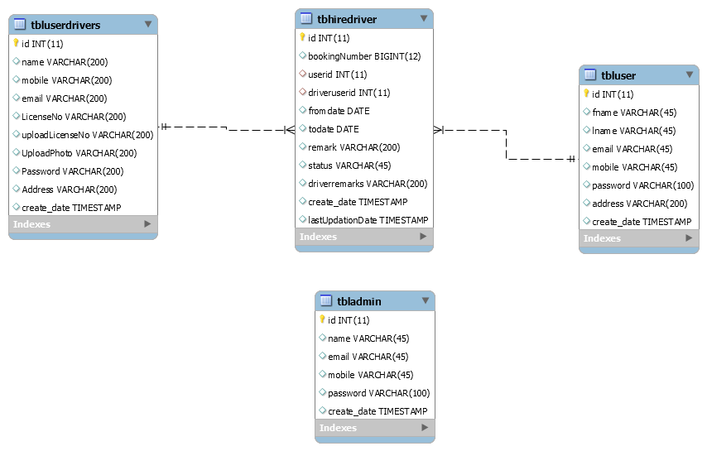
Class Diagram
Notes:
Class Diagram:
A description of set of objects that share the same attributes operations, relationships, and semantics

Slide 14
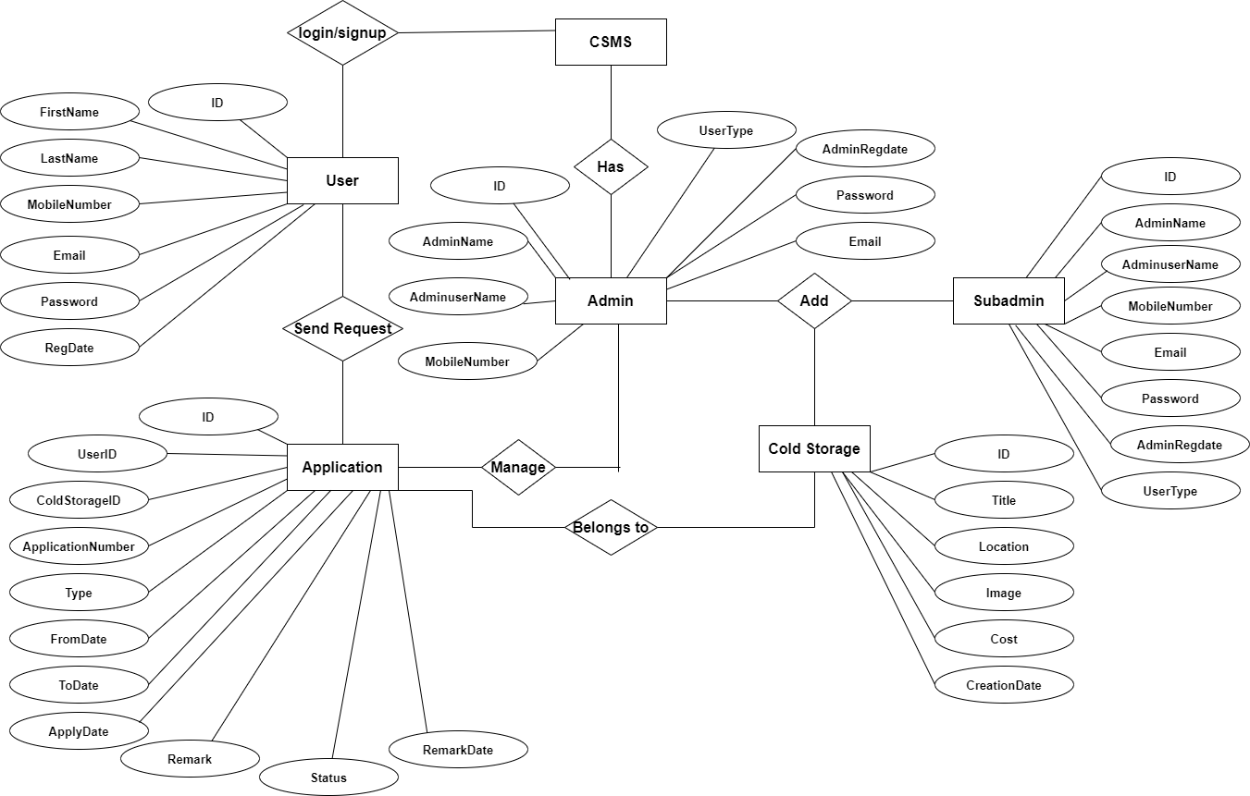
ER Diagram

Slide 15
Implementation and System Testing
After all phase have been perfectly done, the system will be implemented to the server and the system can be used.
System Testing
The goal of the system testing process was to determine all faults in our project .The program was subjected to a set of test inputs and many explanations were made and based on these explanations it will be decided whether the program behaves as expected or not. Our Project went through two levels of testing
Unit testing
Integration testing

Slide 16
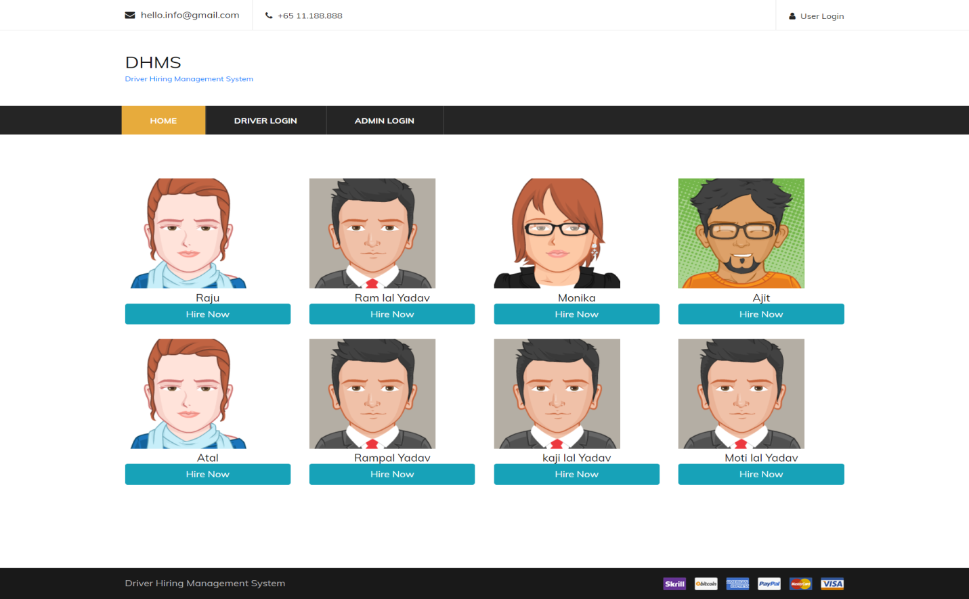
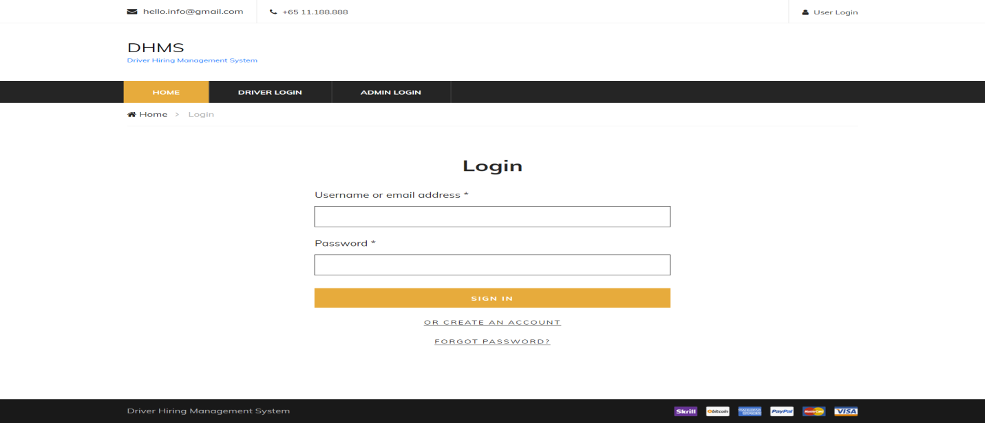
Project Screens

Slide 17
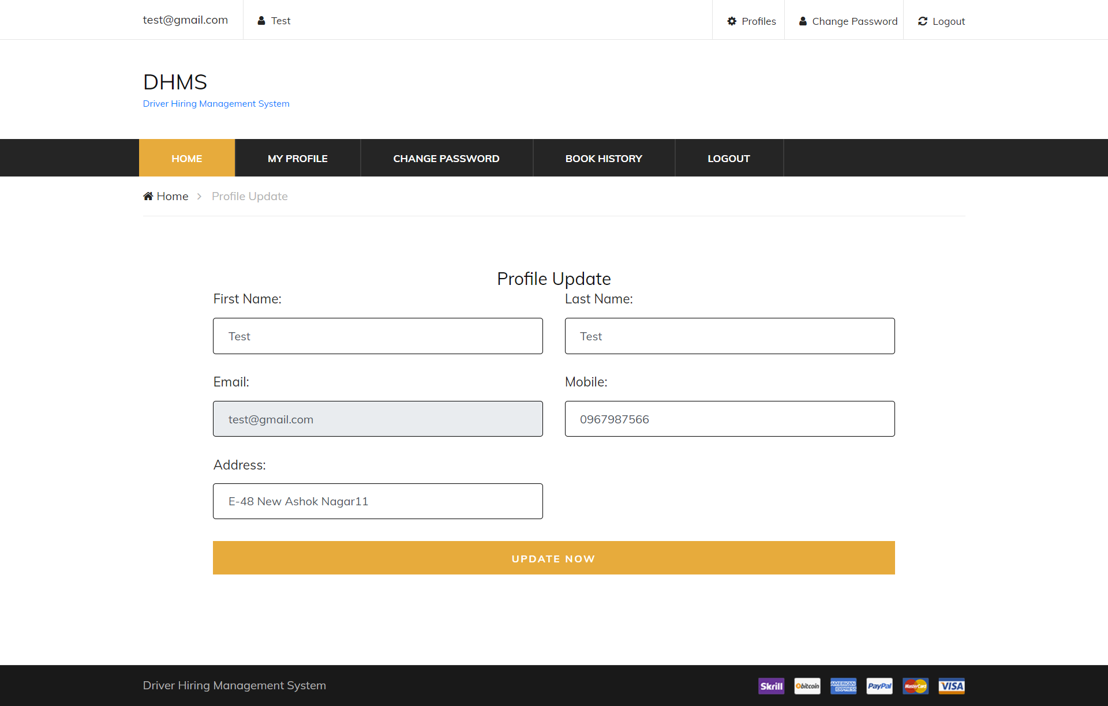
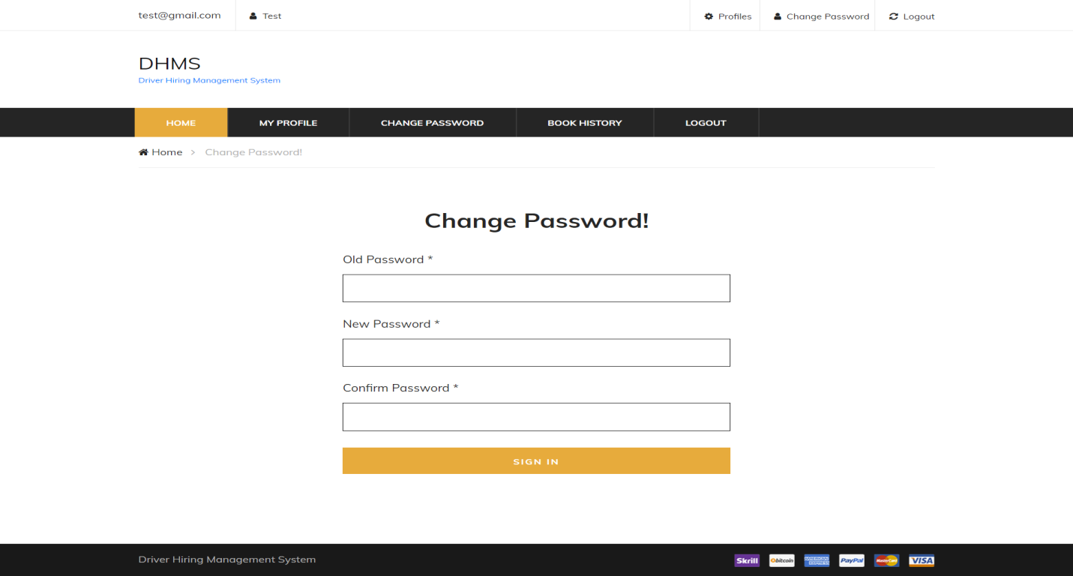

Slide 18
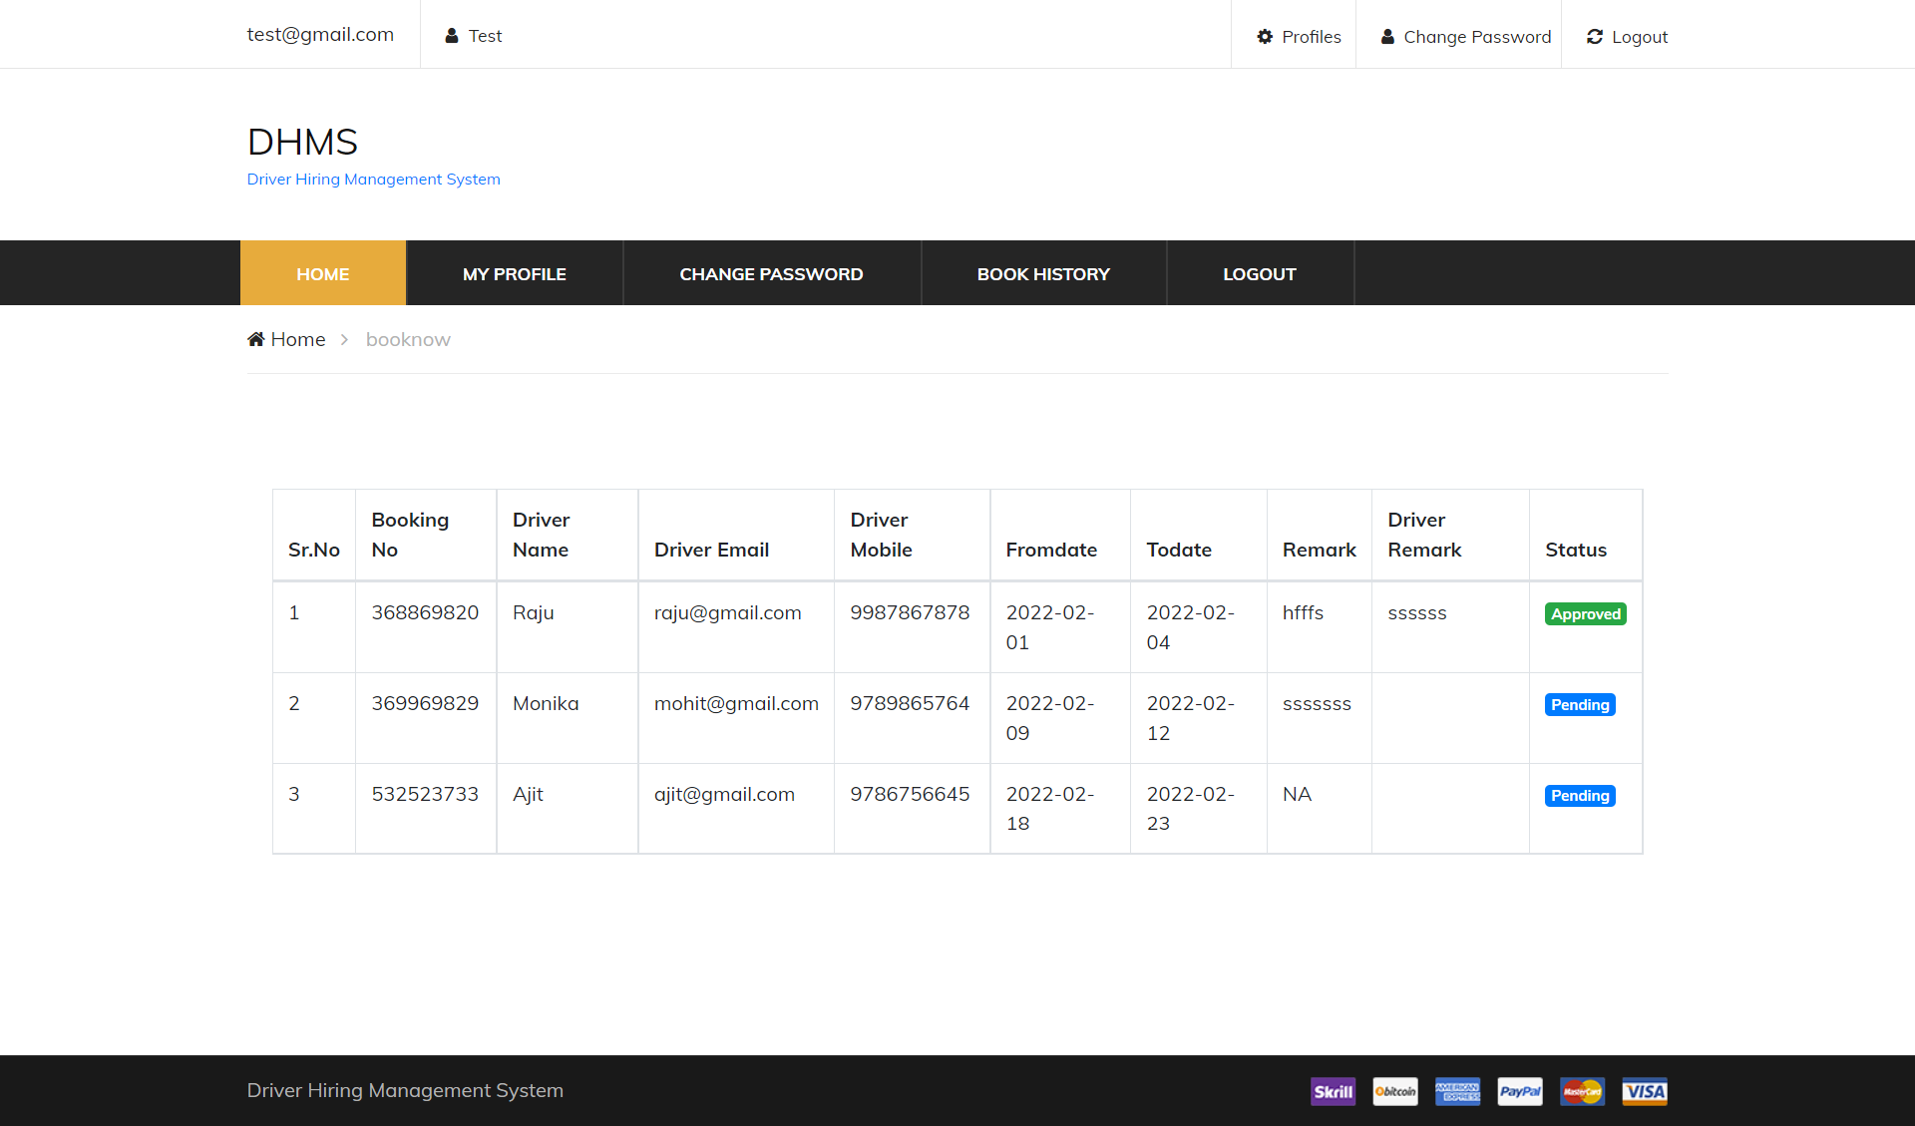
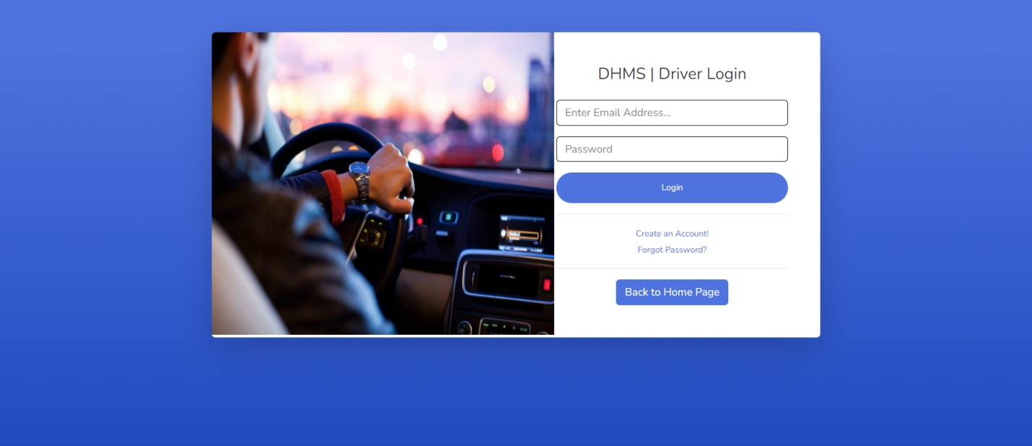

Slide 19
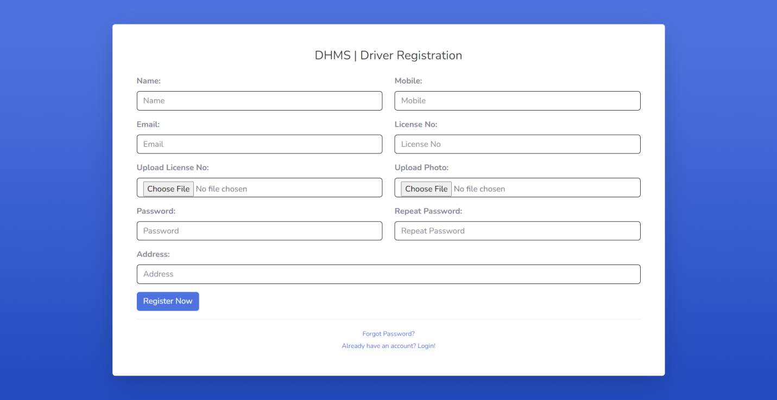
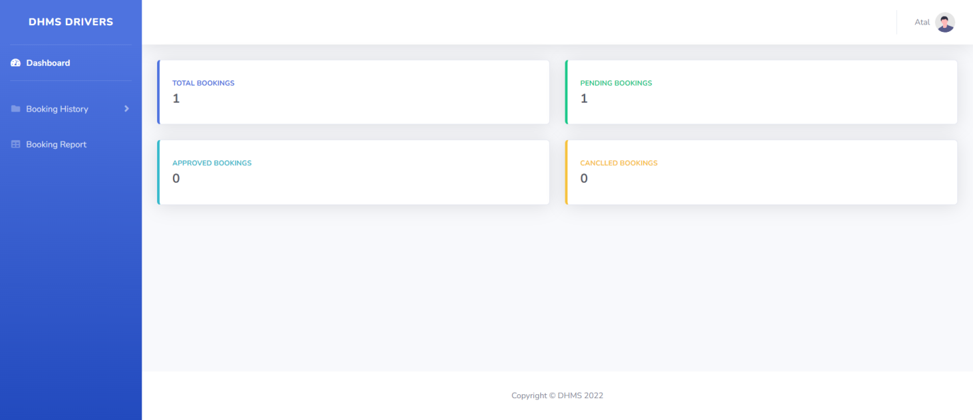

Slide 20
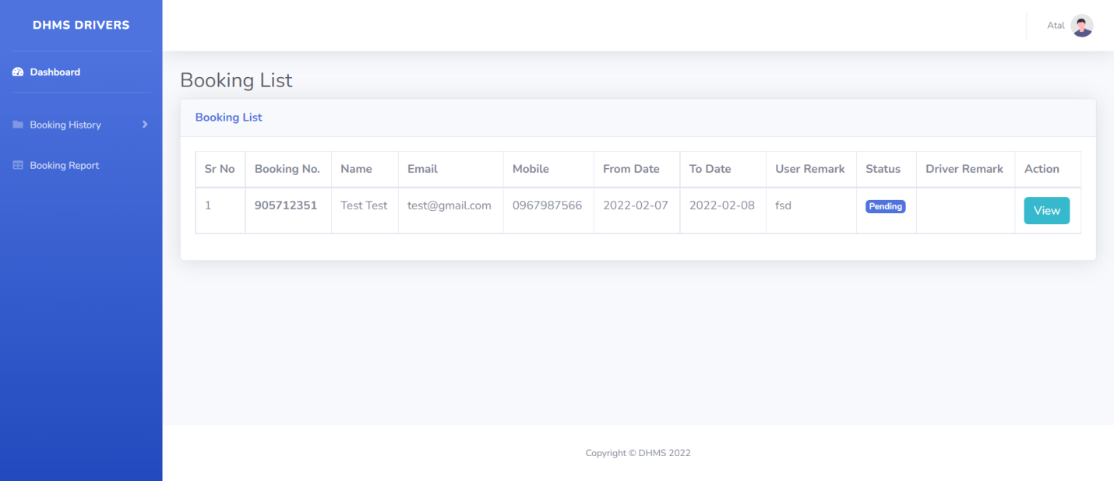
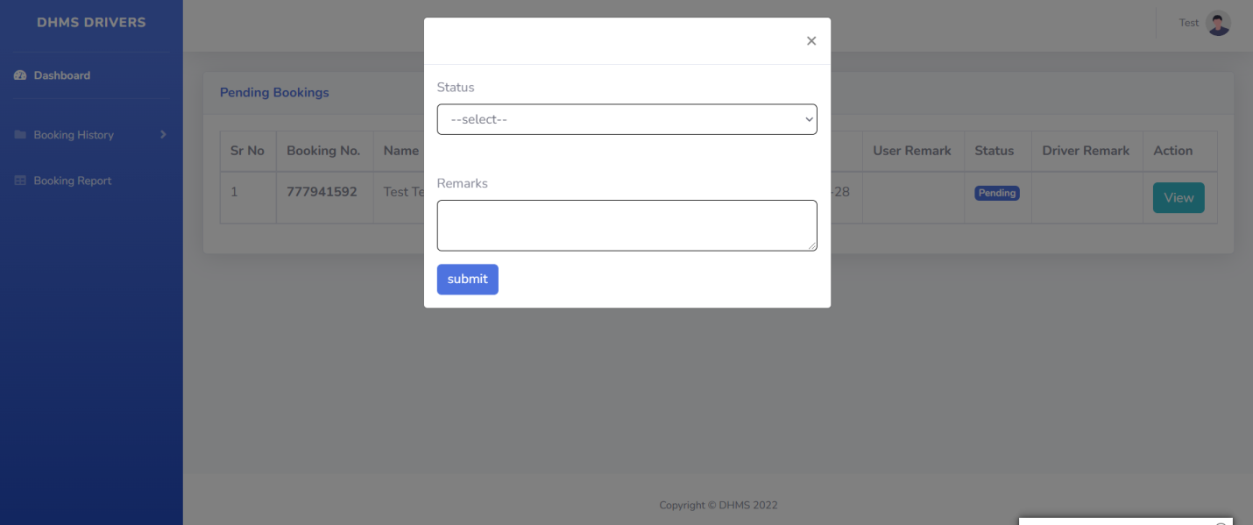

Slide 21
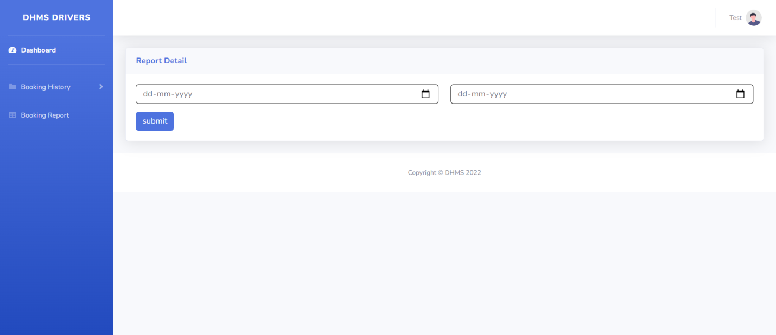
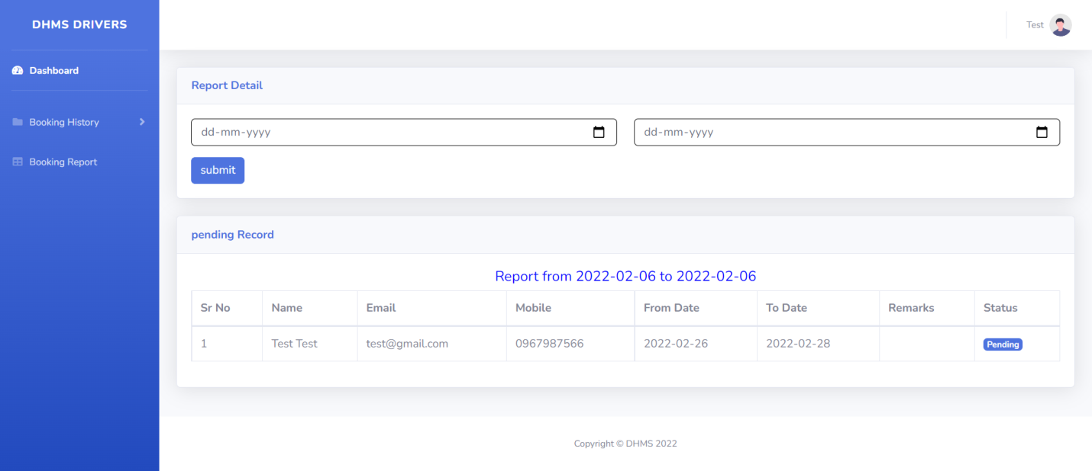

Slide 22
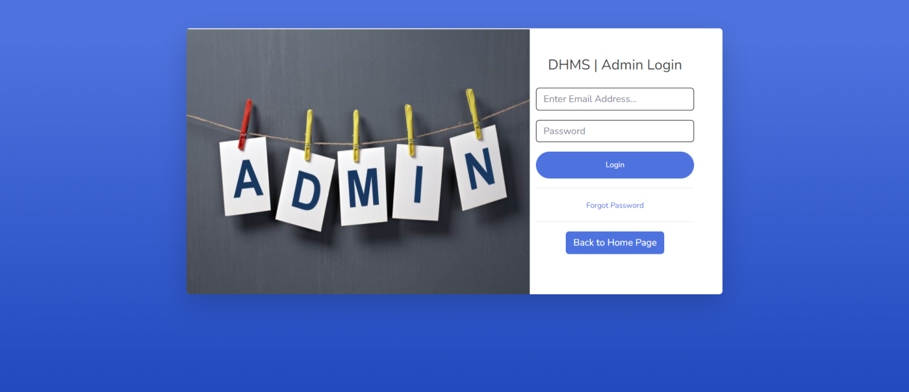
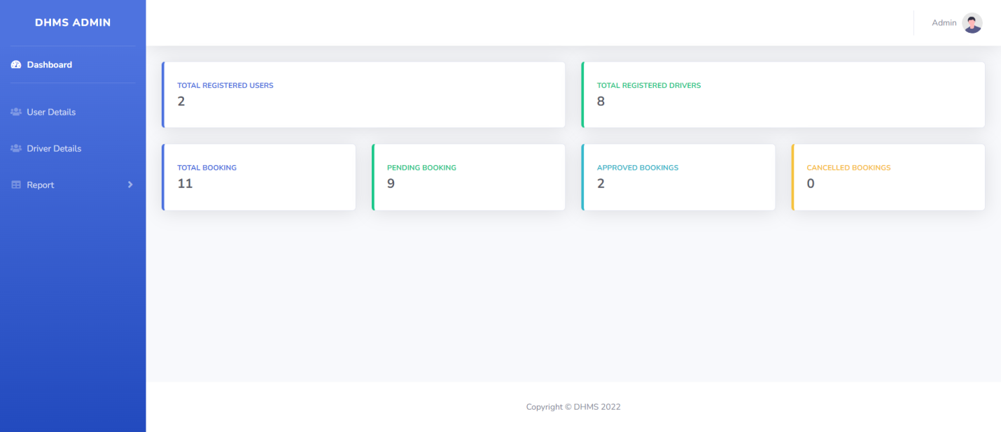

Slide 23
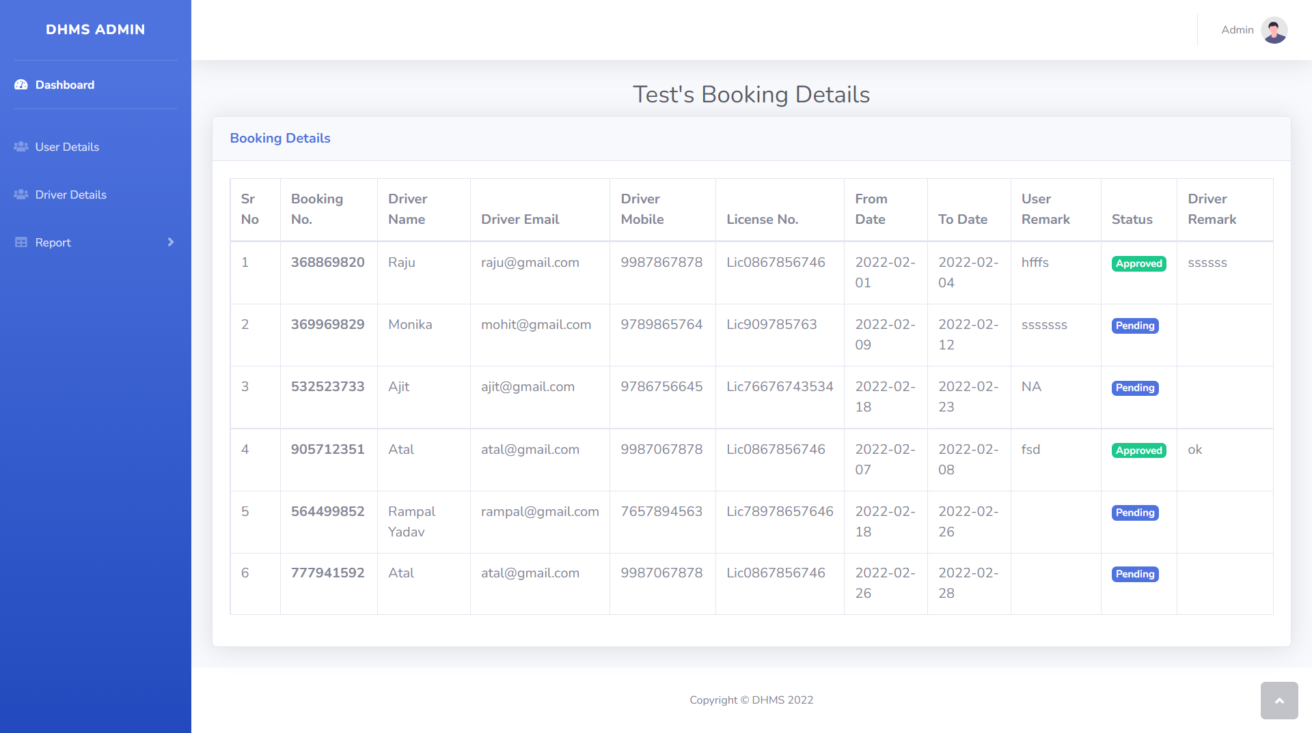

Slide 24
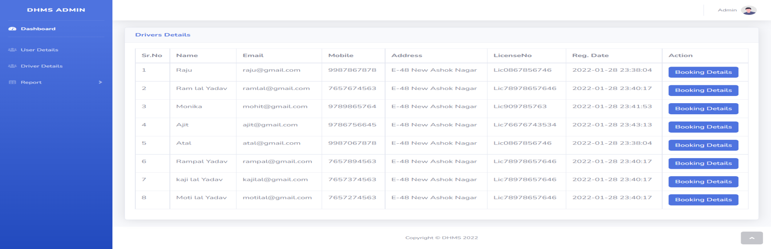
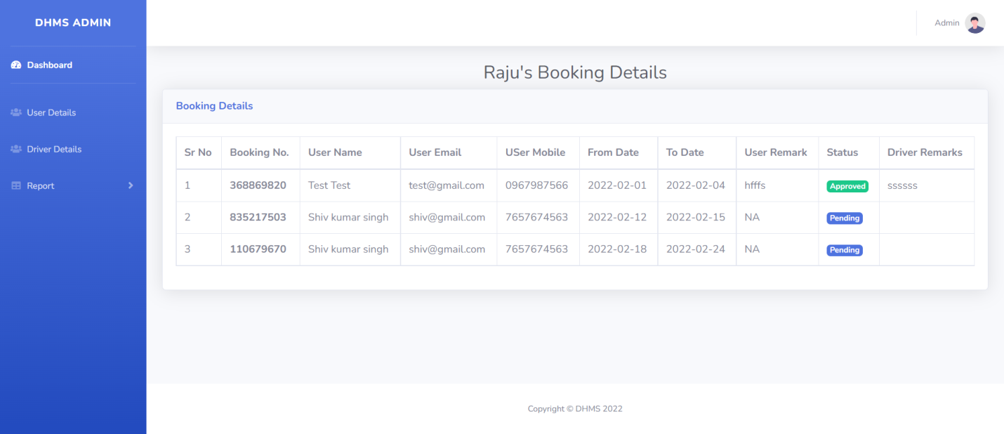

Slide 25
Conclusion
Proposed web application will be easy to customer for hire a driver. Customer can book the driver as per their requirement and get the driver details with acknowledgement to/from the driver online thereby saving time and money.
The Application was designed in such a way that future changes can be done easily. The following conclusions can be deduced from the development of the project.
Automation of the entire system improves the productivity.
It provides a friendly graphical user interface which proves to be better when compared to the existing system.
It gives appropriate access to the authorized users depending on their permissions.
It effectively overcomes the delay in communications.
Updating of information becomes so easier.
System security, data security and reliability are the striking features.
The System has adequate scope for modification in future if it is necessary.

Slide 26
Future Enhancement
I have tried to design the software in such a way that the user may not have any difficulty in using this system and further expansion is also possible. New requirements will be added and risk will be analyzed in every phase until the requirement of user will not be fulfilled. The most priority will be given to keep confidential data secure and easy and simple for use.
The further enhancements which can be made in the system are:
Any requirement that will make system easy to use or make a system secure, these requirement will be add using Spiral Model. Other requirement related to government or municipality will be added when required.
For the identity of user and for their data integrity, digital signature can be added to this system.
For the identity of user and for verification, image of user can be added to this system.
There will be provision of filling form in multiple languages.
A great concern will be given on frontend design which will make user to use system easily and enjoy while using this system.

Slide 27
References
For PHP
https://www.w3schools.com/php/default.asp
https://www.sitepoint.com/php/
https://www.php.net/
For MySQL
https://www.mysql.com/
http://www.mysqltutorial.org
For XAMPP
https://www.apachefriends.org/download.html

Slide 28
Thank You

